Slide 1

Email Spam Classifier

Slide 2
SUBMITTED BY G.CHANDRA MOULI

Slide 3
Introduction
Email system is one of the most effective and commonly used sources of communication. The reason of the popularity of email system lies in its cost effective and faster communication nature. Unfortunately, email system is getting threatened by spam emails. Spam emails are the uninvited emails sent by some unwanted users also known as spammers with the motive of making money.
The email users spend most of their valuable time in sorting these spam mails.
Multiple copies of same message are sent many times which not only affect an organization financially but also irritates the receiving user.
Spam emails are not only intruding the user’s emails but they are also producing large amount of unwanted data and thus affecting the network’s capacity and usage. In this paper, a Spam Mail Detection (SMD) system is proposed which will classify email data into spam and ham emails. The process of spam filtering focuses on three main levels: the email address, subject and content of the message .

Slide 4
Introduction
All mails have a common structure i.e. subject of the email and the body of the email. A typical spam mail can be classified by filtering its content. The process of spam mail detection is based on the assumption that the content of the spam mail is different than the legitimate or ham mail. For example words related to the advertisement of any product, endorsement of services, dating related content etc. The process of spam email detection can be broadly categorized into two approaches: knowledge engineering and machine learning approach.
Knowledge engineering is a network based approach in which IP (internet protocol) address, network address along with some set of defined rules are considered for the email classification. The approach has shown promising results but it is very time consuming. The maintenance and task of updating rules is not convenient for all users. On the other hand, machine learning approach does not involve any set of rules and is efficient than knowledge engineering approach.
The classification algorithm classifies the email based on the content and other attributes.

Slide 5
PROBLEM STATEMENT
Understanding the problem is a crucial first step in solving any machine learning problem. In this article, we will explore and understand the process of classifying emails as spam or not spam. This is called Email Spam Detection, and it is a binary classification problem.
The reason to do this is simple: by detecting unsolicited and unwanted emails, we can prevent spam messages from creeping into the user’s inbox, thereby improving user experience.

Slide 6
Data Pre Processing
Convert the text to lowercase
Remove the punctuations, digits and special characters
Tokenize the text, filter out the adjectives used in the review and create a new column in data frame
Remove the stop words
Stemming and Lemmatising
Applying Text Vectorization to convert text into numeric

Slide 7
Word Cloud
Word Cloud is a visualization technique for text data wherein each word is picturized with its importance in the context or its frequency.
The more commonly the term appears within the text being analysed, the larger the word appears in the image generated.
The enlarged texts are the greatest number of words used there and small texts are the smaller number of words used.

Slide 8
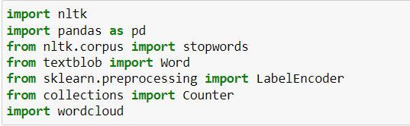
Text Mining Library used

Slide 9
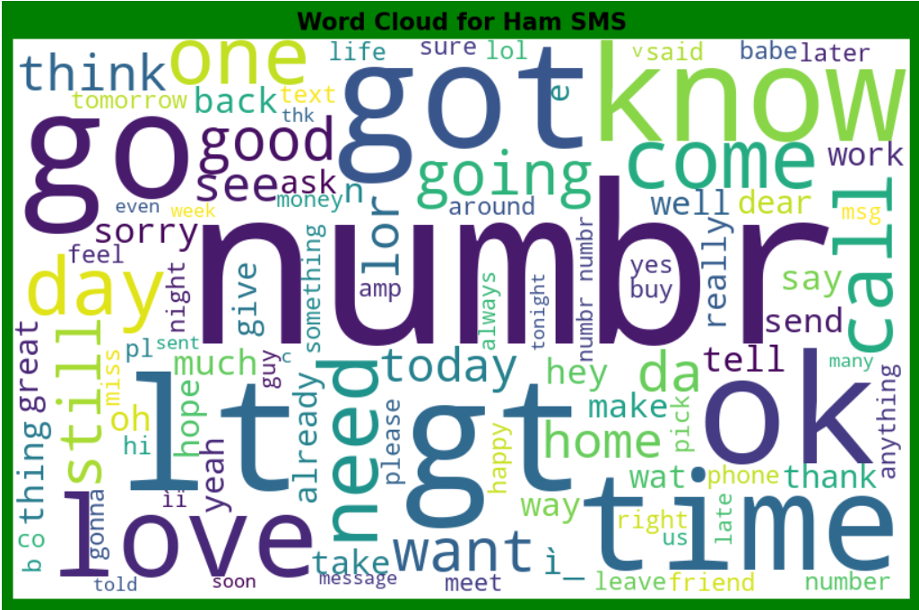

Slide 10
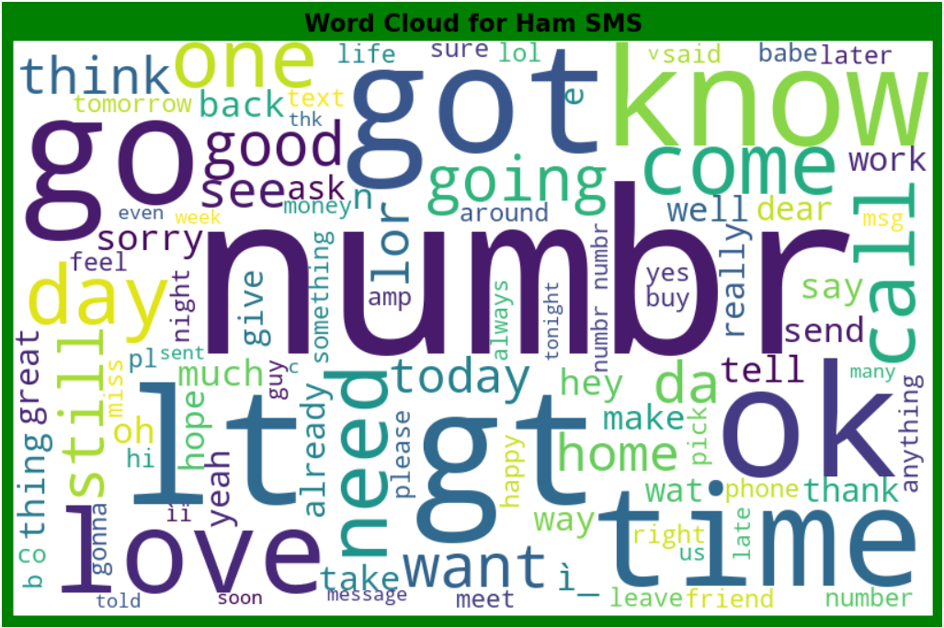

Slide 11
Machine Learning Model Building
The different classification algorithm used in this project to build ML model are as below:
Random Forest classifier
Logistics Regression
AdaBoost Classifier
BernoulliNB Classifier
MultinomialNB Classifier
Support Vector Machine Classifier
ExtraTrees Classifier

Slide 12
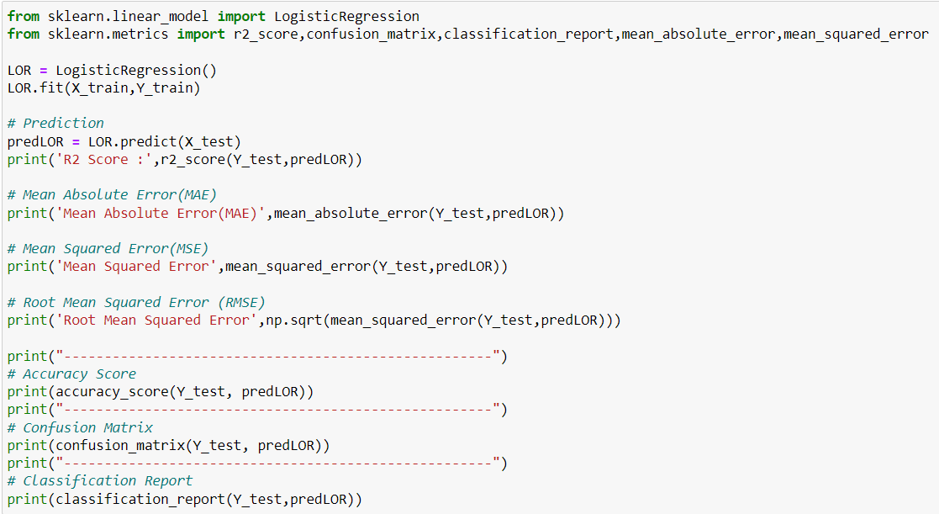
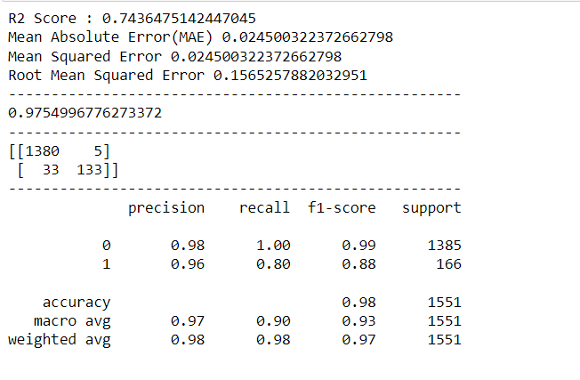
Logistics Regression

Slide 13
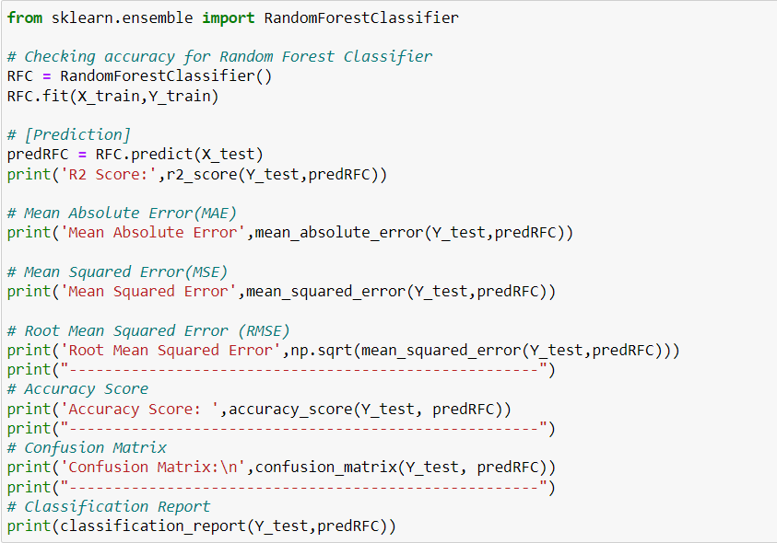
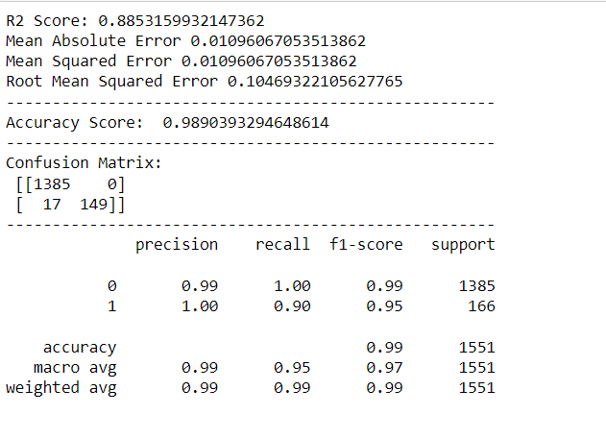
Random Forest classifier

Slide 14
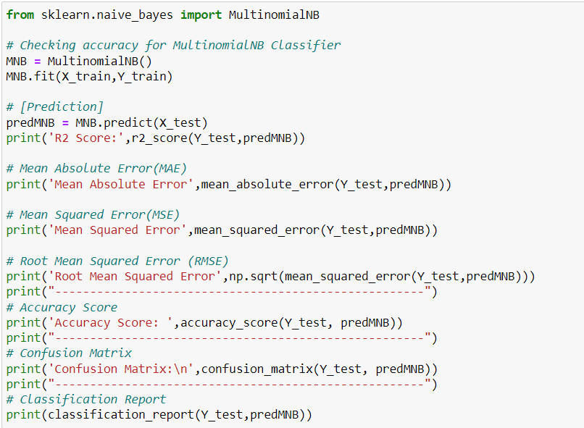
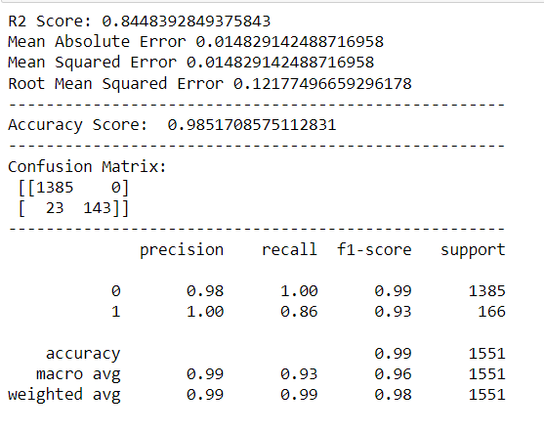
MultinomialNB Classifier

Slide 15
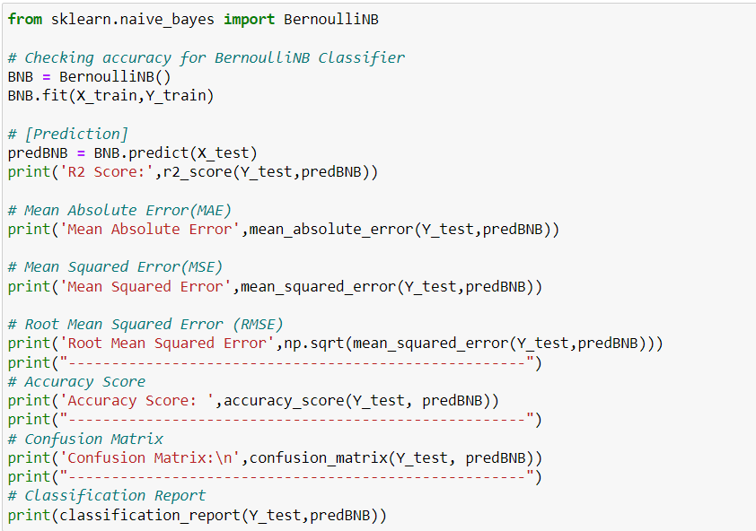
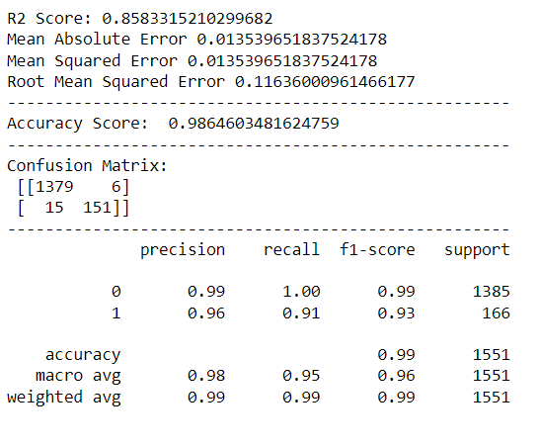
BernoulliNB Classifier

Slide 16
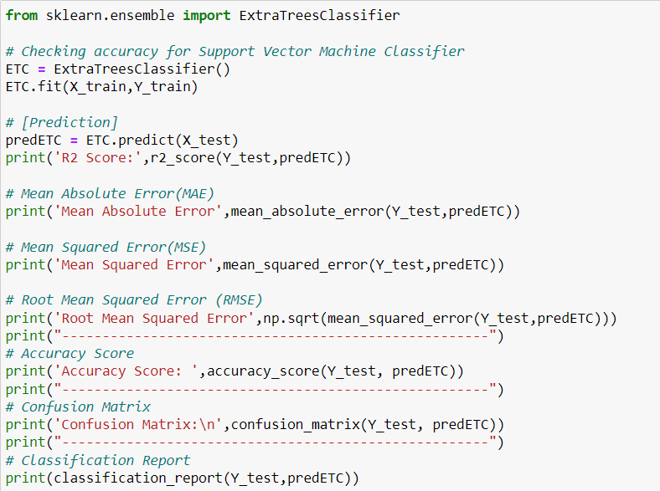
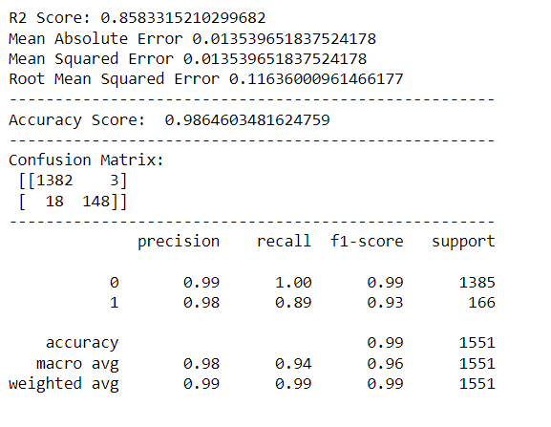
ExtraTrees Classifier

Slide 17
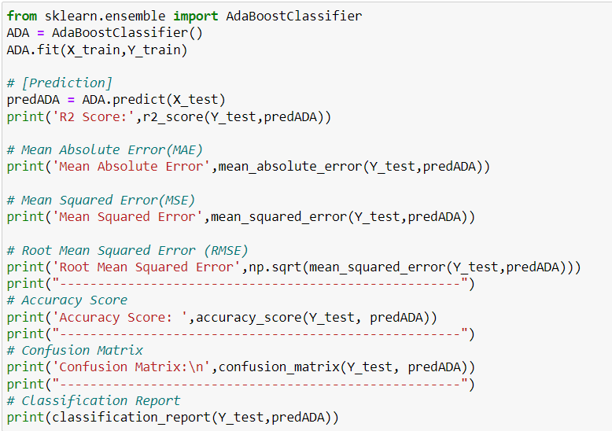
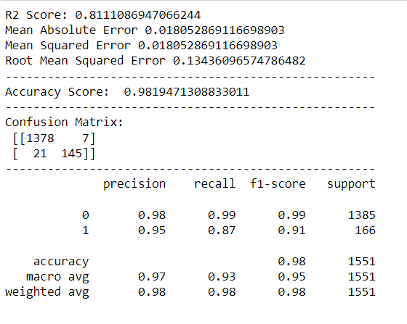
AdaBoost Classifier

Slide 18
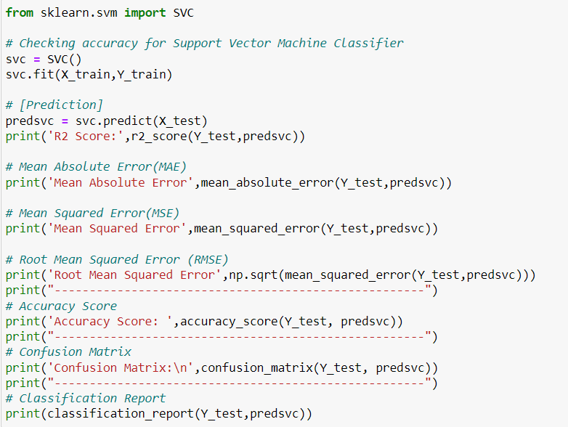
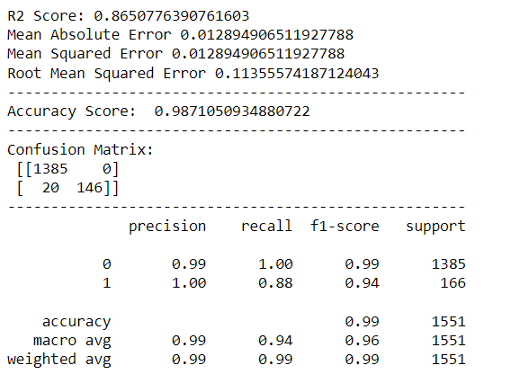
Support Vector Machine Classifier

Slide 19
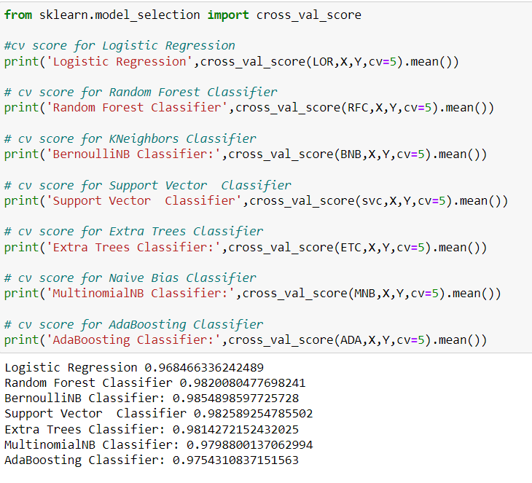
Cross Validation Score

Slide 20
CONCLUSION
Successfully developed Machine learning model to predict product review ratings.
NLTK library used for text Mining.
BernoulliNB classifier model is best model with accuracy score of 98.54%.

Slide 21
Thank You

